Slide 1
Telco Customer Analysis
By: Feras Abdel-Rahim & Jacob Nava

Slide 2
Overview
Examine the Telecommunication data to gain an initial understanding
Evaluate the data of the Telecommunication customer base
Use data visualization to derive meaningful insights about the customers
Use data mining techniques to discover customer behavior
Apply this knowledge to derive meaningful business applications
Explain how these can be used to improve the business

Slide 3
Background
Customer churn represents the percentage of clients who stop using a company’s services within a given time period
High churn can lead to significant revenue loss and increased customer acquisition costs
Understanding the drivers of churn helps businesses retain customers and improve service strategies
This analysis uses a publicly available telecom customer dataset to investigate factors influencing churn
Focus is placed on contract type, tenure, and service usage to explore patterns

Slide 4
Project Motivation
Reduce Customer Churn
It is significantly cheaper to retain existing customers than to acquire new ones.
Predicting churn early enables proactive retention activities.
Optimize Business Costs
Saves on re-acquisition and marketing expenses.
Enables better budgeting of retention programs.

Slide 5
Project Motivation cont.
Leverage Data for Strategic Decisions
Demonstrates a method to turn raw customer data into actionable business insight.
Empowers data-driven culture within telecom operations.
Improve Customer Experience
Identifies which customers are at risk and why.
Enables personalized outreach (e.g., contract offers, service improvements).

Slide 6
Data Description
Source: Publicly available Telco Customer Churn dataset (Kaggle)
Total Records: 7,043 customer entries
Target Variable:
Churn – whether a customer left the company (Yes/No)
Key Feature Categories:
Customer Info: gender, senior citizen, partner, dependents
Account Info: tenure, contract type, paperless billing, payment method
Services Signed Up: phone, internet, streaming, device protection
Billing Details: monthly charges, total charges
Data Type Breakdown:
Binary: 7 features
Categorical: 11 features
Continuous: 3 features

Slide 7
Data Heatmap
Heat map is a visualization method that employs color to represent the magnitude of values in a matrix.
It is typically built from a correlation matrix, which have a range between -1 and 1
Heatmaps are applied to show the direction and magnitude of relationships between variables
Correlation heat maps can show which variables are most related to the target (Churn)
Simpler to make data relationships understandable to technical stakeholders in a single visual overview.

Slide 8
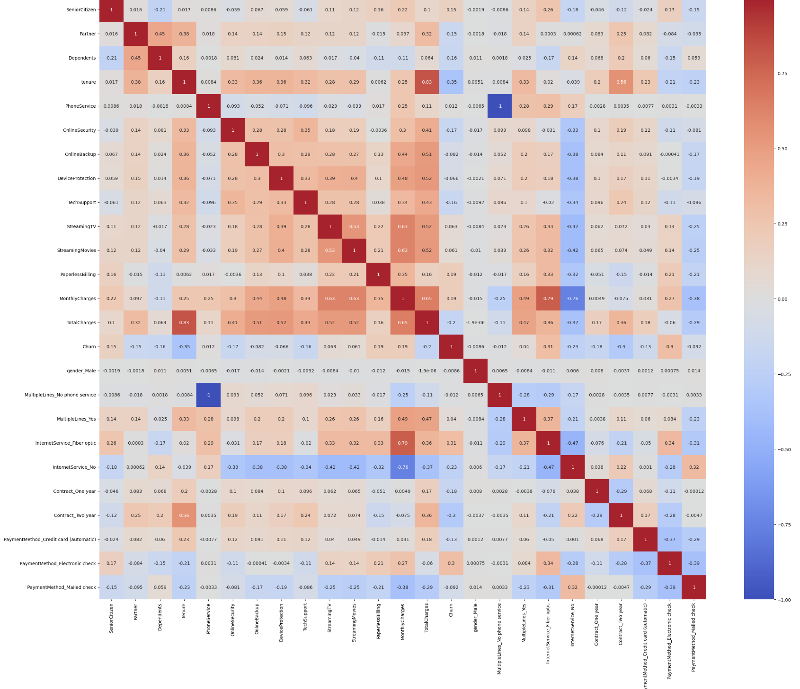
Data Heatmap
Tenure & Contract 2 year have the strongest negative correlation
Internet service fiber optic & payment method fiber optic have the strongest positive correlation
These are the 4 biggest factors that contribute to high and low churn rate in customers

Slide 9
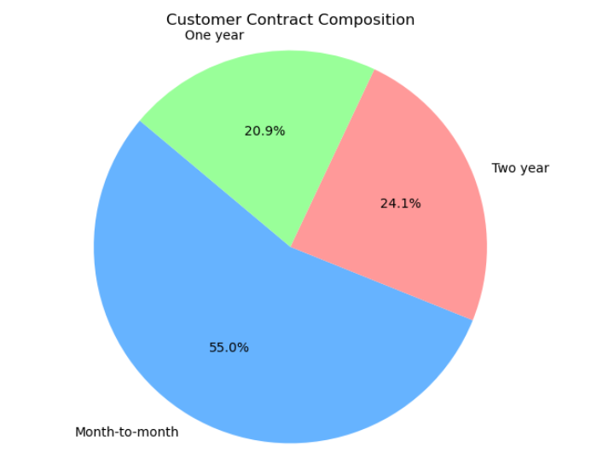
Data Pie Chart #1
What type of contracts do customers use?
Over half of all customers (55%) are on month-to-month contracts
One-year (24%) and two-year (21%) contracts make up the rest
Indicates most customers prefer flexibility, which may affect retention

Slide 10
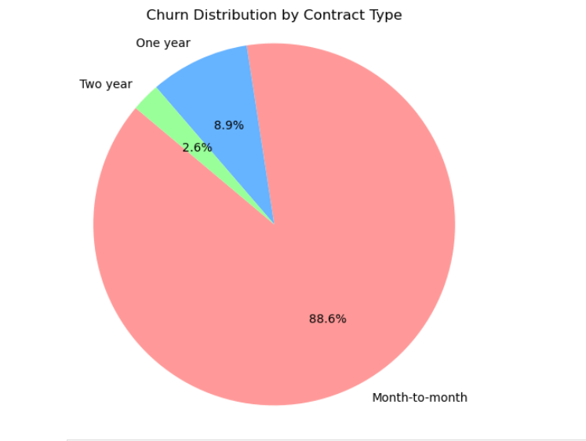
Data Pie Chart # 2
Who is actually leaving?
Nearly 89% of churn comes from month-to-month customers
Very low churn among one-year and two-year contract holders
Suggests that longer contracts lead to better retention
Major opportunity: Target churn interventions at month-to-month base

Slide 11
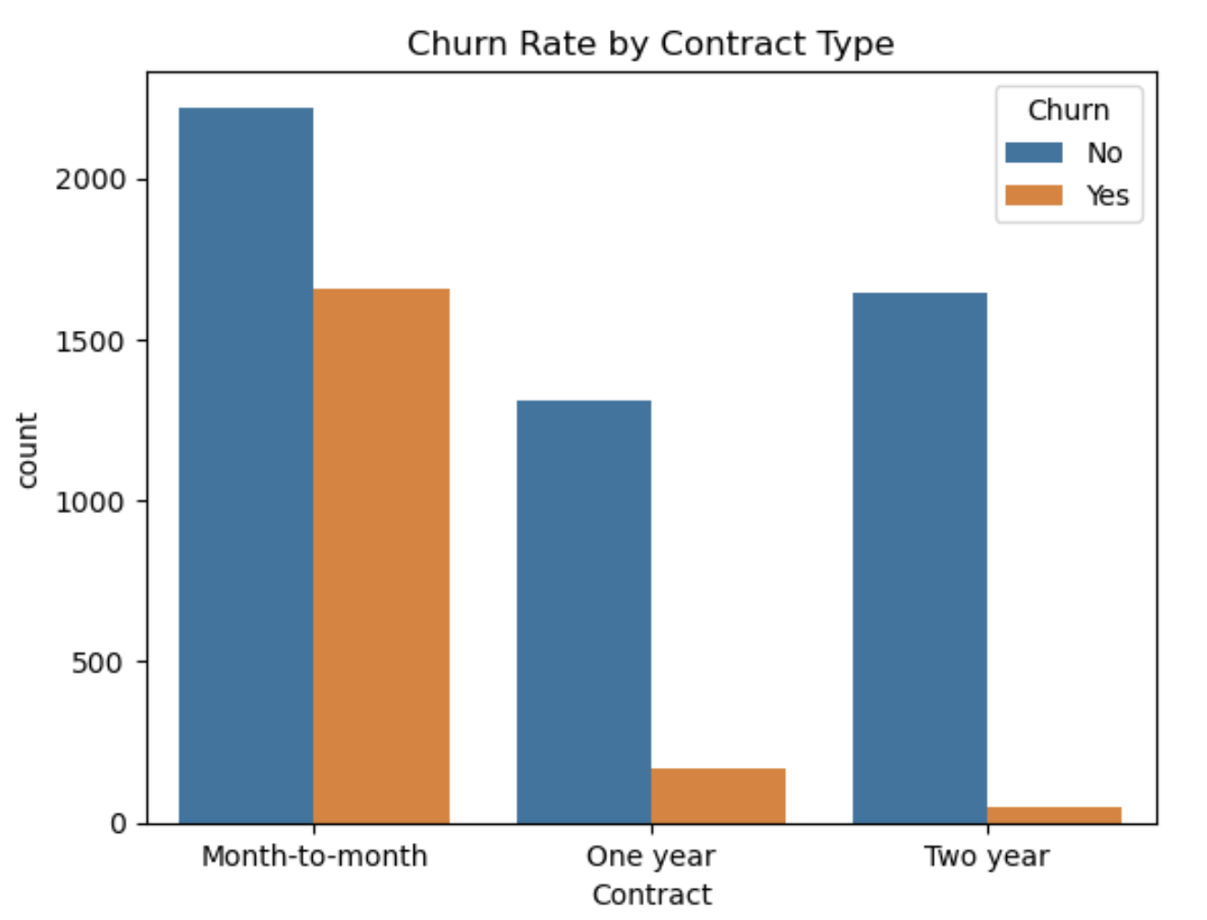
Bar Chart
Visual Comparison
This bar chart is a side by side comparison for the active customers in each contract type and the rate at which they churn
Visual confirms that contract length is a strong churn predictor

Slide 12
Key Findings - Contract Type Analysis
Most churn comes from month-to-month customers (88.6%), despite making up only 55% of the customer base
Longer contracts (1-year, 2-year) are far more stable — very low churn rates
Short-term contracts = higher risk, but also opportunity to apply churn reduction strategies
Customer Retention: Longer contracts are associated with higher customer retention which suggest they encourage loyalty or commitment.

Slide 13
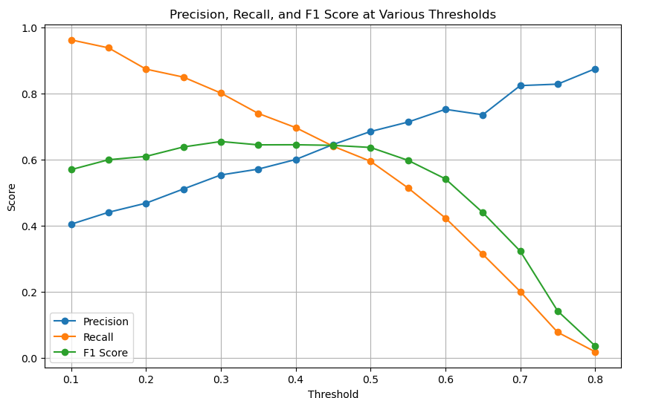
Logistic Regression - Model Evaluation
Evaluated thresholds to balance precision and recall
F1 Score peaked at threshold = 0.3, indicating the best trade-off
We selected threshold = 0.4 to maintain strong recall while improving precision

Slide 14
What is Accuracy, Precision, and Recall?
Accuracy:
Measures how often the model is correct overall
Good for general performance, but may hide class imbalance issues.
Precision:
Out of all customers predicted to churn, how many actually did?
Important when acting on predictions that cost money (e.g.,discounts, specials, etc.)
Recall:
Out of all customers who actually churned, how many did we catch?
Critical for identifying and saving at-risk customers before they leave

Slide 15
Key Findings - Logistic Regression
Final model results:
Accuracy = 80%
Recall (Churn) = 70%
Precision (Churn) = 60%
This balance helps reduce customer loss while minimizing false alarms
Prioritizes high recall to identify the majority of at-risk churn customers
Improves precision over threshold = 0.3, reducing false positives
Maintains accuracy at 80%, supporting model reliability
Understanding this trade-off helps us a business take smarter, more cost-effective action

Slide 16
Decision Trees
A tree-like graphical decision model that is utilized for classifying data by splitting it based on some significant attributes.
Used for predicting behaviors like customer churn or purchase behavior.
Clear & Intuitive: Easily understood and explained by business teams.
Flexible with Data: Easily deals with numbers and categories (e.g., monthly charges, contract type).
Focuses on Key Drivers: It recognizes the most influential factors that trigger customer churn.
Minimal Preparation Needed: It yields good outcomes with little data cleaning or data transformation necessary.

Slide 17
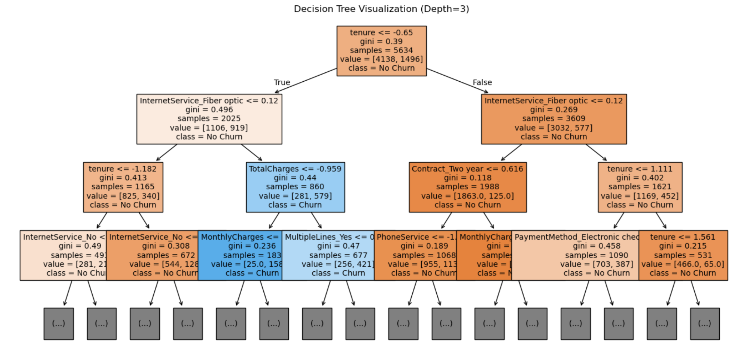
Decision Tree Visualization

Slide 18
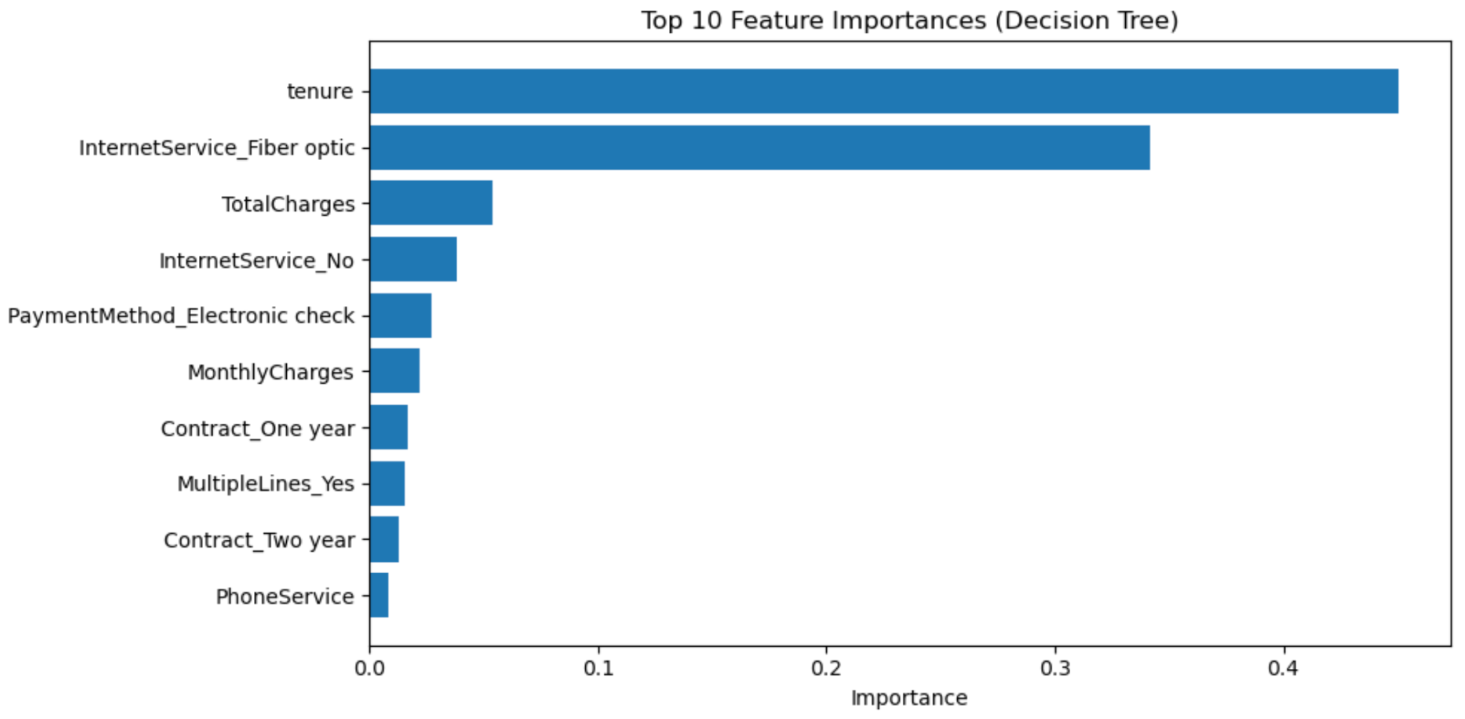
Decision Tree Features

Slide 19
Key Findings - Decision Tree
1. Tenure is the most critical predictor of churn
Customers with shorter tenure (newer customers) are much more likely to churn
Longer-tenure customers show stronger loyalty
This justifies the need for early contact methods
2. Fiber Optic Customers are More Likely to Churn
Those customers with fiber optic service are more likely to churn compared to those who have DSL or no internet
Increased cost or performance issues

Slide 20
Key Findings - Decision Tree cont.
3. Total Charges and Monthly Charges influence churn
High monthly or total charges are associated with increased churn, suggesting that pricing may be a pain point
4. Contract Type Has Major Impact
Two-year contract subscribers are much less likely to churn
Enhances the business benefit of long-term contracts in reducing churn

Slide 21
Overall Summary
Conducted a complete data mining process on Telco customer churn data (7,043 records)
Cleaned, visualized, and transformed data for binary classification
Explored key features influencing churn: Contract Type, Tenure, Internet Service, and Charges
Built and evaluated Logistic Regression and Decision Tree models
Chose threshold = 0.4 to balance recall (70%) and precision (60%)
Achieved strong performance: 80% accuracy, actionable predictions

Slide 22
Business Insights
Promote 1–2 year contracts with incentives to stabilize the customer base
Conduct a review of the fiber optics internet service to determine pricing or quality issues to address dissatisfied customers that may churn
Add a loyalty program to encourage and incentivize being a long-term customer while rewarding contract renewal
Launch a targeted retention campaign focused on customers flagged as high risk by the model, ensuring resources are prioritized where they’ll have the most impact

Slide 23
Citation
The Dataset provided was taken from https://www.kaggle.com/datasets/blastchar/telco-customer-churn
The code was generated/edited with help of GenAI

